Slide 1
Web Essentials
Week 7 + 8
Positionering

Slide 2
Positionering

Slide 3
Fouten bij positionering
Gebruik NOOIT tabellen om je webpagina te lay-outen
Waarom niet: => Veel HTML-code nodig => HTML is voor inhoud; de inhoud is geen tabel => Minder mogelijkheden omdat alles in tabelvorm moet passen => Enorm geknoei bij het responsive maken van je website

Slide 4
De css display property
Elementen hebben een display eigenschap: - display: inline - display: inline-block - display: block - display: flex - display: none - …

Slide 5
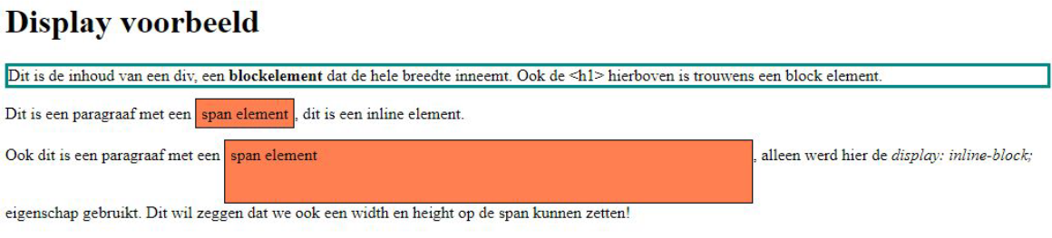
De css display property

Slide 6
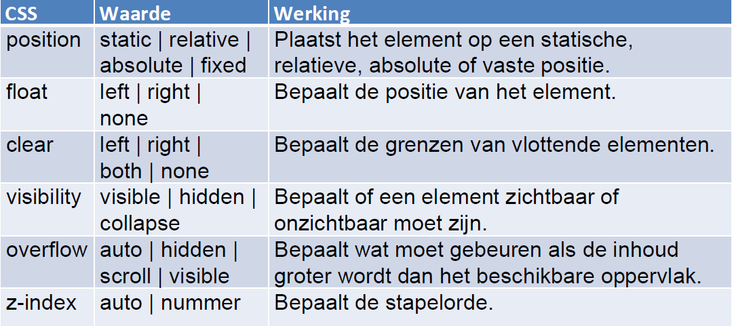
Andere css-properties voor positionering

Slide 7
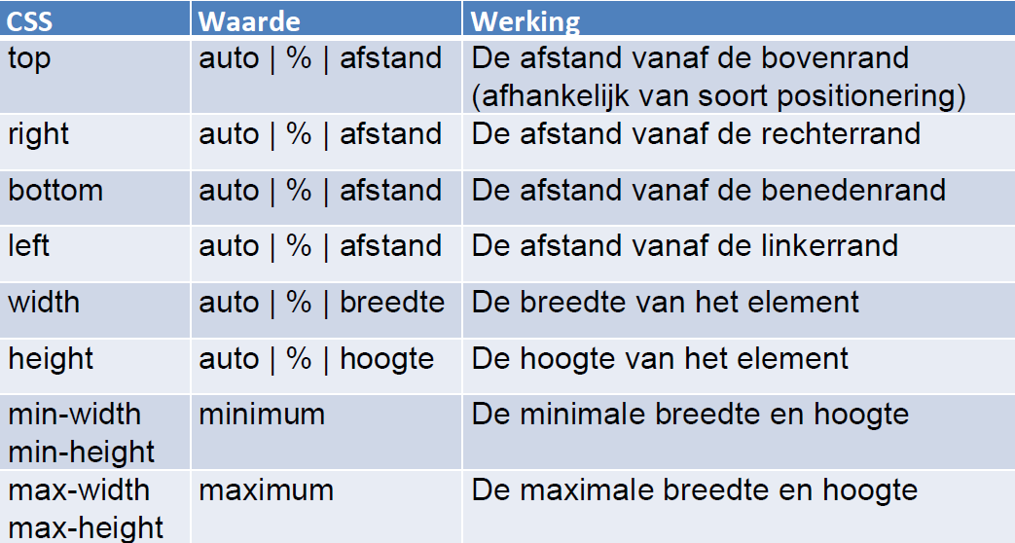
Andere css-properties voor positionering

Slide 8

Het <span>-element
Een span-element wordt gebruikt voor de opmaak van inline elementen zonder specifieke betekenis.
.naam {
background-color: gray;
font-style: italic;
}
<p>Twee domme blondjes, <span class="naam">Paris</span> en
<span class="naam">Britney</span>, lopen samen hand in hand
over straat.
Opeens zegt <span class="naam">Britney</span> tegen <span
class="naam">Paris</span>: ‘Ik heb zo-even een zwangerschaptest
gedaan’, waarop <span class="naam">Paris</span> zegt: ‘En,
waren de vragen moeilijk?’</p>

Slide 9
Het indelen van een pagina
- Het <div> (division) element => Voornamelijk gebruikte voor de opmaak van blokelementen zonder specifieke betekenis. => Kan zowel blokelementen als inline-elementen bevatten. => Wordt gebruikt om content die bij elkaar hoort te blijven te groeperen.
- De HTML5-structuurelementen => <nav>, <header>, <footer>, <section>, <article>, <aside>

Slide 10
Opmaak

Slide 11
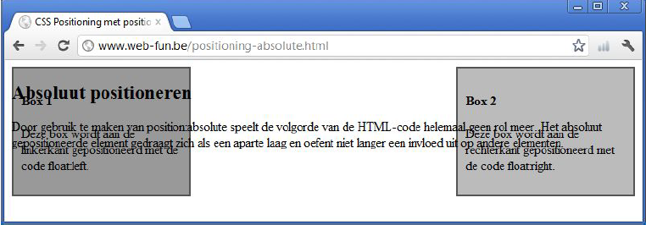
Absolute opmaak
Position: absolute
De volgorde van HTML-code speelt geen rol meer
Het absoluut gepositioneerde element gedraagt zich als een aparte laag en oefent niet langer een invloed uit op andere elementen

Slide 12
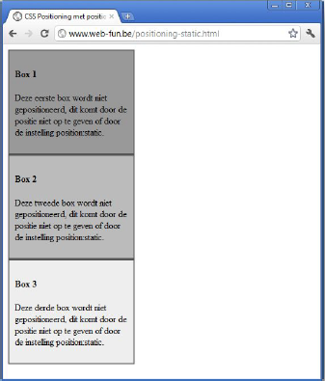
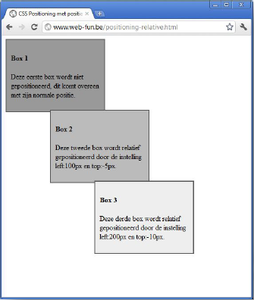
Relatieve opmaak
Position: relative
Positionering van het element ten opzichte van de normale positie die dit element zou hebben
Verschuift het element met top, right, bottom en left

Slide 13
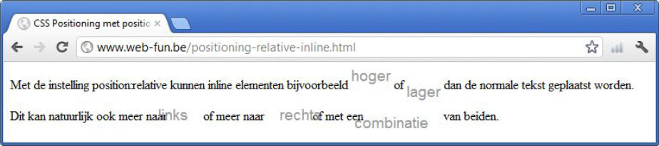
Relatieve opmaak
- Position: relative kan ook op inline elementen toegepast worden
- Blijft ruimte innemen op de normale positie

Slide 14
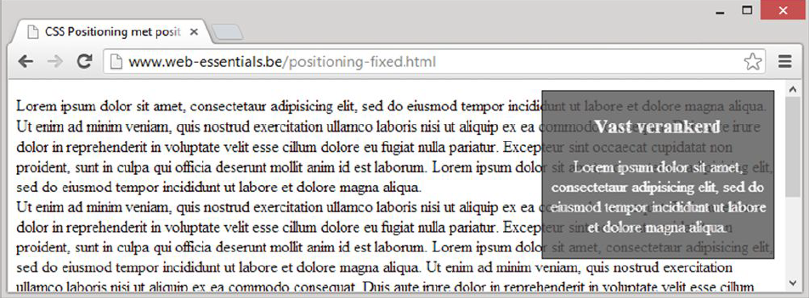
Vaste positie
Position: fixed Objecten vast verankeren binnen het zichtbare veld van het browserventer, dit scrollt dus mee.

Slide 15
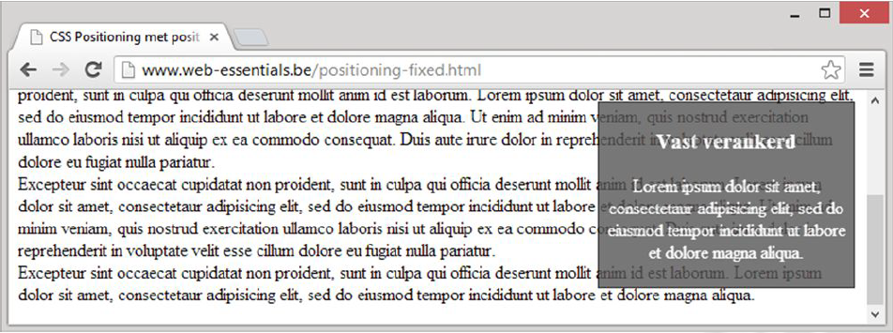
Vaste positie
Position: fixed Objecten vast verankeren binnen het zichtbare veld van het browserventer, dit scrollt dus mee.

Slide 16
width & height
Voor block elements (of inline-block) zijn width en height instelbaar
Dit kan relatief (%, vw, vh) of met een gegeven waarde (bv. px) - width: 600px; -> element neemt altijd 600px in beslag
Optie: min-width en/of max-width -max-width: 600px; -> element neemt 600px in beslag, indien mogelijk

Slide 17
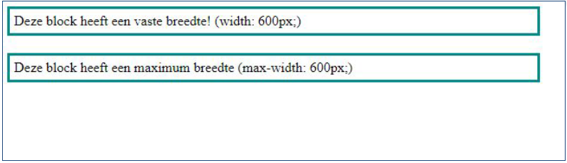
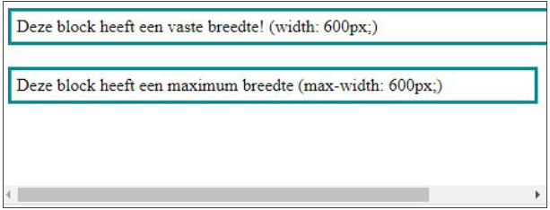
width vs max-width

Slide 18
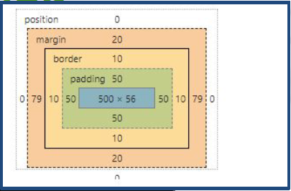
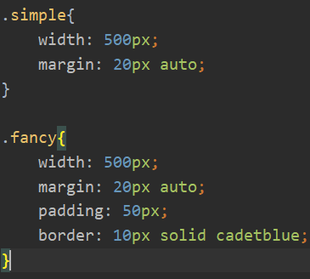
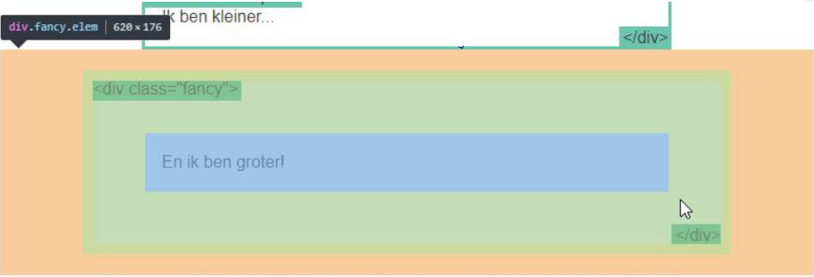
Box-sizing

Slide 19
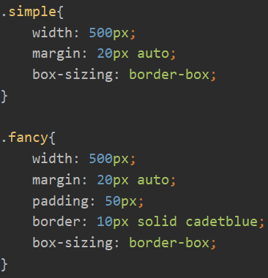
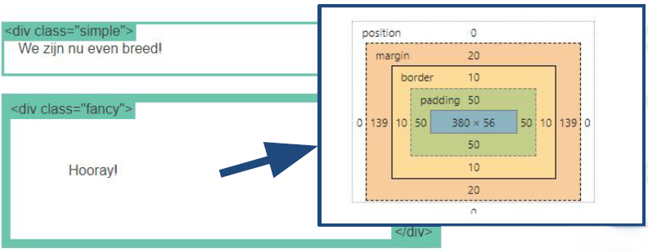
Box-sizing

Slide 20
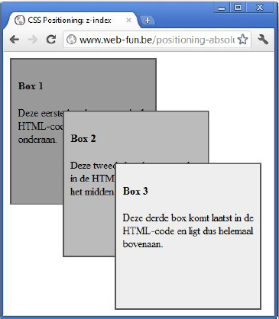
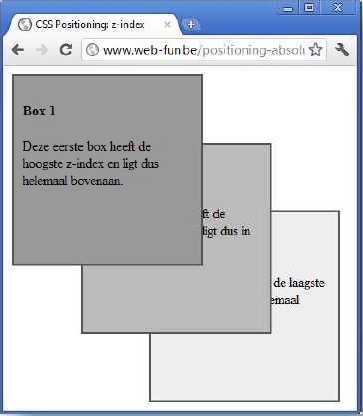
Stapelvolgorde
z-index: Normaal is de volgorde van HTML-code bepalend. -> laatste in de DOM (HTML-structuur) is bovenaan op de ‘stapel’
Aanpasbaar: z-index: 3; -> komt boven z-index: 2

Slide 21
Flexbox (flex-container)

Slide 22
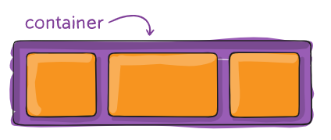
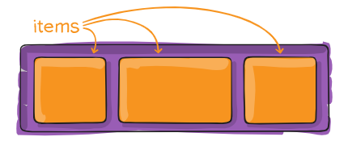
Flexbox
Flexbox kan je gebruiken om elementen te positioneren binnen een bepaalde container.
De container definieer je mbv de css-property display: flex;
Vervolgens geef je mee hoe je wilt dat de child elements zich gaan verdelen/plaatsen binnen die container.

Slide 23
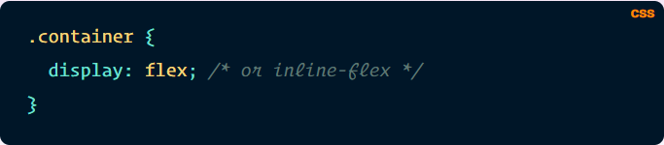
Flex container - display
display
This defines a flex container; inline or block depending on the given value. It enables a flex context for all its direct children.

Slide 24
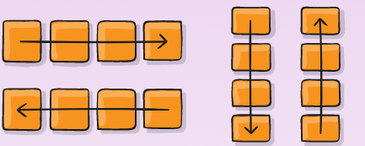
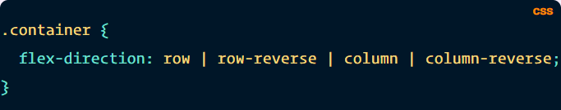
Flex container – flex-direction
This establishes the main-axis, thus defining the direction flex items are placed in the flex container. Flexbox is (aside from optional wrapping) a single-direction layout concept. Think of flex items as primarily laying out either in horizontal rows or vertical columns.

Slide 25
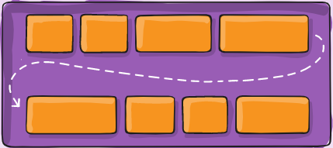
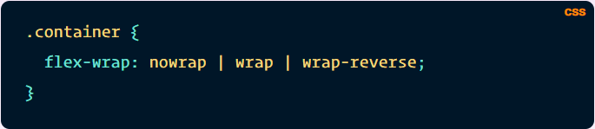
Flex container – flex-wrap
By default, flex items will all try to fit onto one line. You can change that and allow the items to wrap as needed with this property.

Slide 26
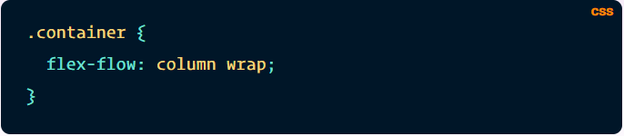
Flex container – flex-flow
This is a shorthand for the flex-direction and flex-wrap properties, which together define the flex container’s main and cross axes. The default value is row nowrap.

Slide 27
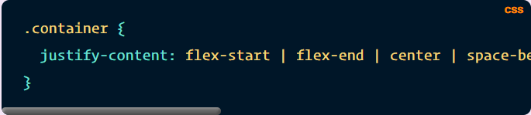
Flex container – justify-content
This defines the alignment along the main axis. It helps distribute extra free space leftover when either all the flex items on a line are inflexible, or are flexible but have reached their maximum size. It also exerts some control over the alignment of items when they overflow the line.

Slide 28
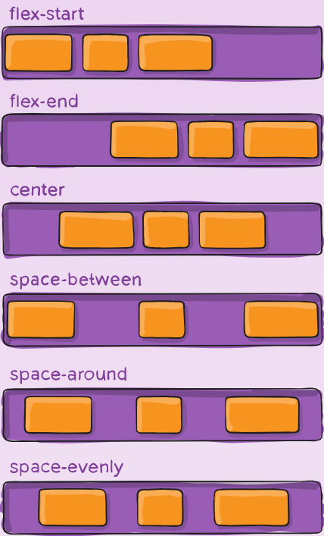
Flex container – justify-content
- flex-start (default): items are packed toward the start of the flex-direction.
- flex-end: items are packed toward the end of the flex-direction.
- center: items are centered along the line
- space-between: items are evenly distributed in the line; first item is on the start line, last item on the end line
- space-around: items are evenly distributed in the line with equal space around them. Note that visually the spaces aren’t equal, since all the items have equal space on both sides. The first item will have one unit of space against the container edge, but two units of space between the next item because that next item has its own spacing that applies.
- space-evenly: items are distributed so that the spacing between any two items (and the space to the edges) is equal.

Slide 29
Flex container – align-items
This defines the default behavior for how flex items are laid out along the cross axis on the current line. Think of it as the justify-content version for the cross-axis (perpendicular to the main-axis).

Slide 30
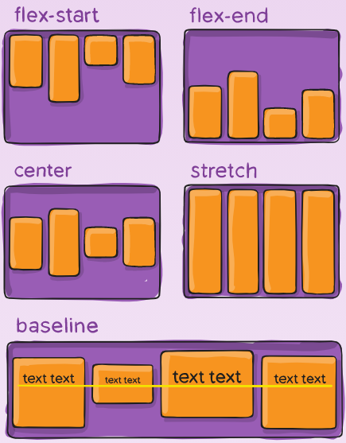
Flex container – align-items
stretch (default): stretch to fill the container (still respect min-width/max-width)
flex-start / start / self-start: items are placed at the start of the cross axis. The difference between these is subtle, and is about respecting the flex-direction rules or the writing-mode rules.
flex-end / end / self-end: items are placed at the end of the cross axis. The difference again is subtle and is about respecting flex-direction rules vs. writing-mode rules.
center: items are centered in the cross-axis
baseline: items are aligned such as their baselines align

Slide 31
Flex container – align-content
align-content
This aligns a flex container’s lines within when there is extra space in the cross-axis, similar to how justify-content aligns individual items within the main-axis.
Note: This property only takes effect on multi-line flexible containers, where flex-flow is set to either wrap or wrap-reverse). A single-line flexible container (i.e. where flex-flow is set to its default value, no-wrap) will not reflect align-content.

Slide 32
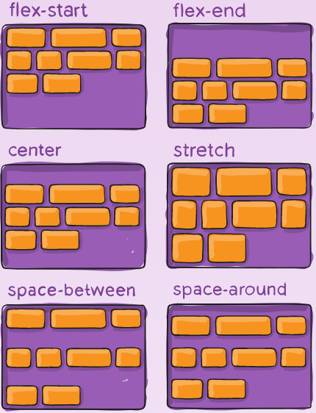
Flex container – align-content
normal (default): items are packed in their default position as if no value was set.
flex-start / start: items packed to the start of the container. The (more supported) flex-start honors the flex-direction while start honors the writing-mode direction.
flex-end / end: items packed to the end of the container. The (more support) flex-end honors the flex-direction while end honors the writing-mode direction.
center: items centered in the container
space-between: items evenly distributed; the first line is at the start of the container while the last one is at the end
space-around: items evenly distributed with equal space around each line
space-evenly: items are evenly distributed with equal space around them
stretch: lines stretch to take up the remaining space

Slide 33
Flexbox (flex-items)

Slide 34
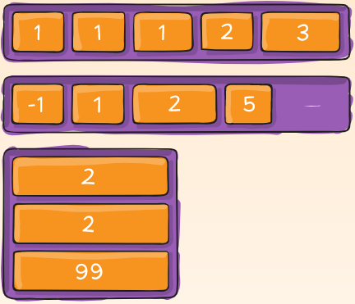
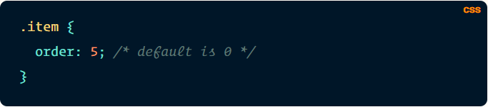
Flexbox - order
By default, flex items are laid out in the source order. However, the order property controls the order in which they appear in the flex container.

Slide 35
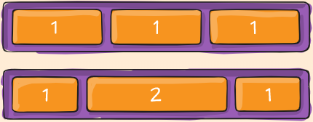
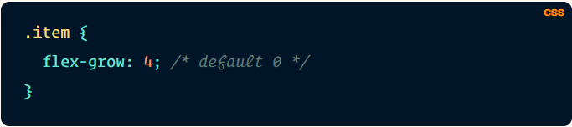
Flexbox – flex-grow & flex-shrink
This defines the ability for a flex item to grow if necessary. It accepts a unitless value that serves as a proportion. It dictates what amount of the available space inside the flex container the item should take up.
If all items have flex-grow set to 1, the remaining space in the container will be distributed equally to all children. If one of the children has a value of 2, the remaining space would take up twice as much space as the others (or it will try to, at least).

Slide 36
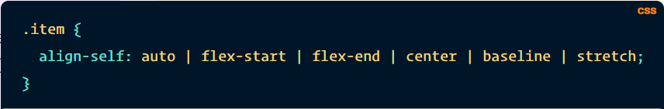
Flexbox – align-self
This allows the default alignment (or the one specified by align-items) to be overridden for individual flex items.
Please see the align-items explanation to understand the available values.

Slide 37
Oefeningen
Flexbox learning game
Flexbox webflow
Flexbox defense game
Guide to flexbox
Algemene uitleg positionering
All about floats (lees dit artikel zeker eens!)

